Slide 1
Database Design - Normalization
Databases Systems [BS-IV(cs/se)] [Spring 2022]
Most of the content was taken from slides of book “Database System Concepts, 7th Ed, Silberschatz, Korth and Sudarshan”

Slide 2
Combined Schema → redundant data
Problems -Data Anomalies
Insertion
Deletion
Updation (modification)
Solution: Decomposition
Should be lossless and dependency preservation
Using Functional Dependencies
Partial
Full
Transitive
Using FD Closure
Normalization

Slide 3
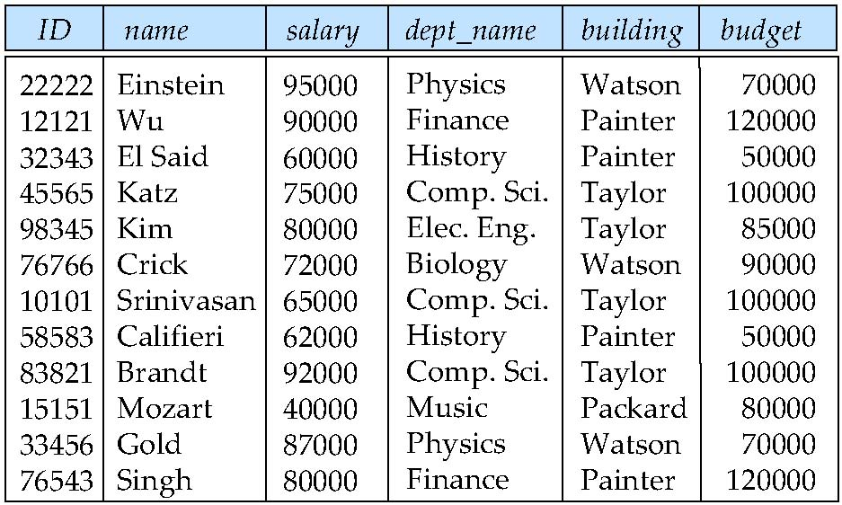
Combine Schemas?
Suppose we combine instructor and department into inst_dept
(No connection to relationship set inst_dept)
Result is possible repetition of information

Slide 4
What About Smaller Schemas?
Suppose we had started with inst_dept. How would we know to split up (decompose) it into instructor and department?
Write a rule “if there were a schema (dept_name, building, budget), then dept_name would be a candidate key”
Denote as a functional dependency:
dept_name → building, budget
In inst_dept, because dept_name is not a candidate key, the building and budget of a department may have to be repeated.
This indicates the need to decompose inst_dept
Not all decompositions are good. Suppose we decompose employee(ID, name, street, city, salary) into employee1 (ID, name)
employee2 (name, street, city, salary)
The next slide shows how we lose information -- we cannot reconstruct the original employee relation -- and so, this is a lossy decomposition.

Slide 5
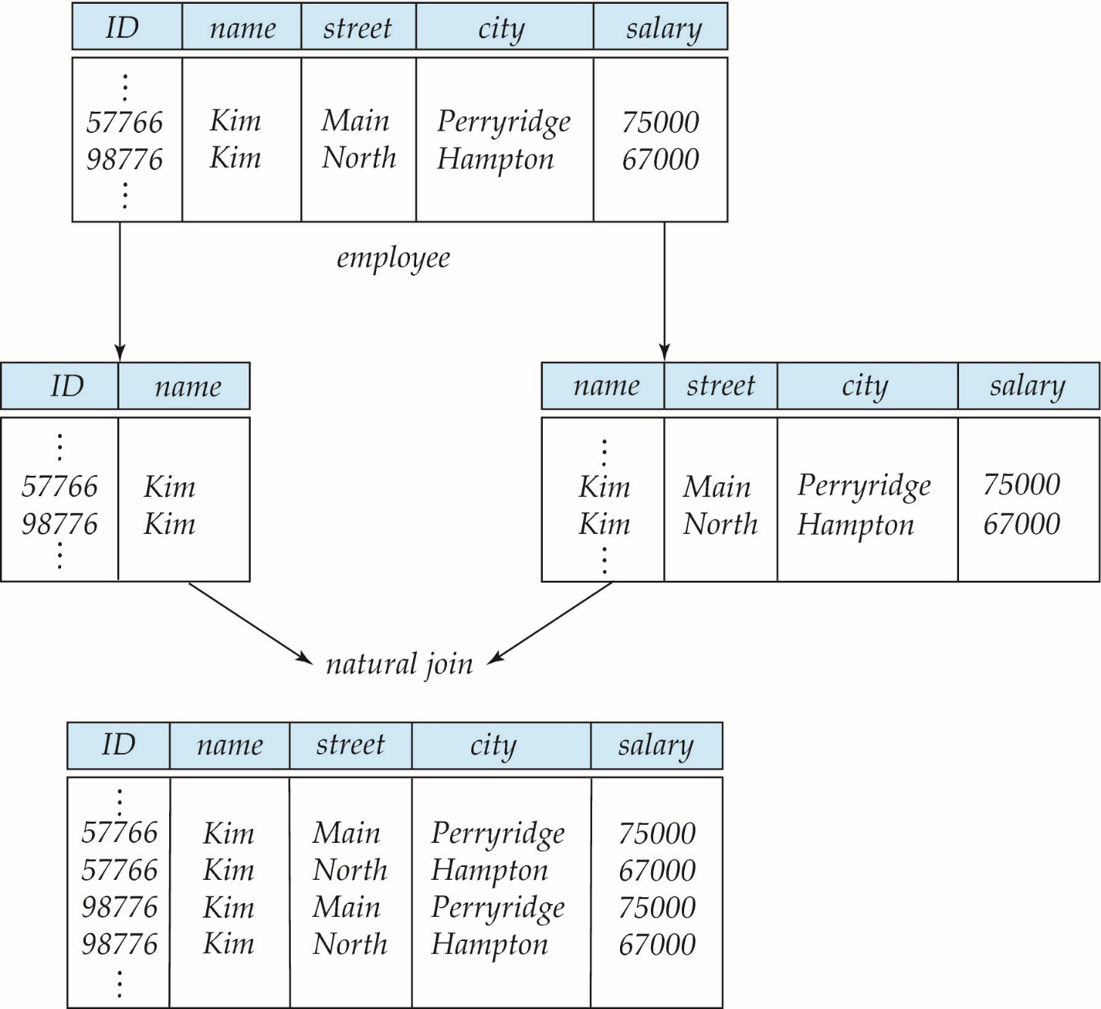
A Lossy Decomposition

Slide 6
Example of Lossless-Join Decomposition
Lossless join decomposition
Decomposition of R = (A, B, C) R₁ = (A, B) R₂ = (B, C)
A
B
C
A
B
B
C
α
β
1
2
A
B
α
β
1
2
1
2
A
B
∏_{B,C}(r)
r
∏_{A,B}(r)
A
B
C
∏_{A} (r) ∏_{B} (r)
α
β
1
2
A
B

Slide 7
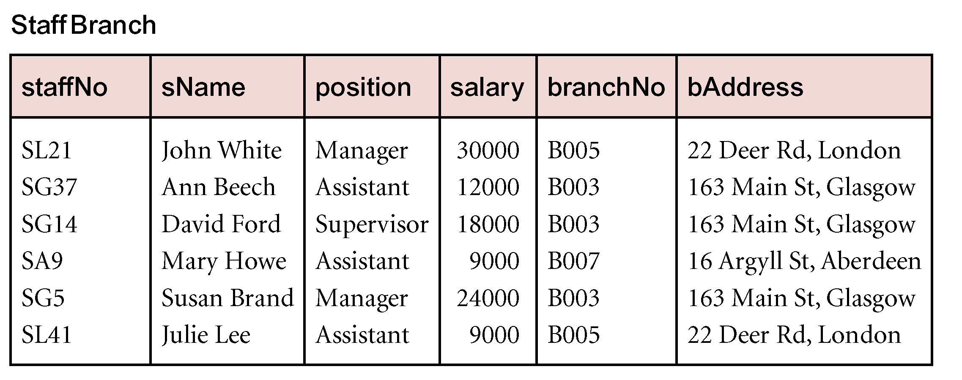
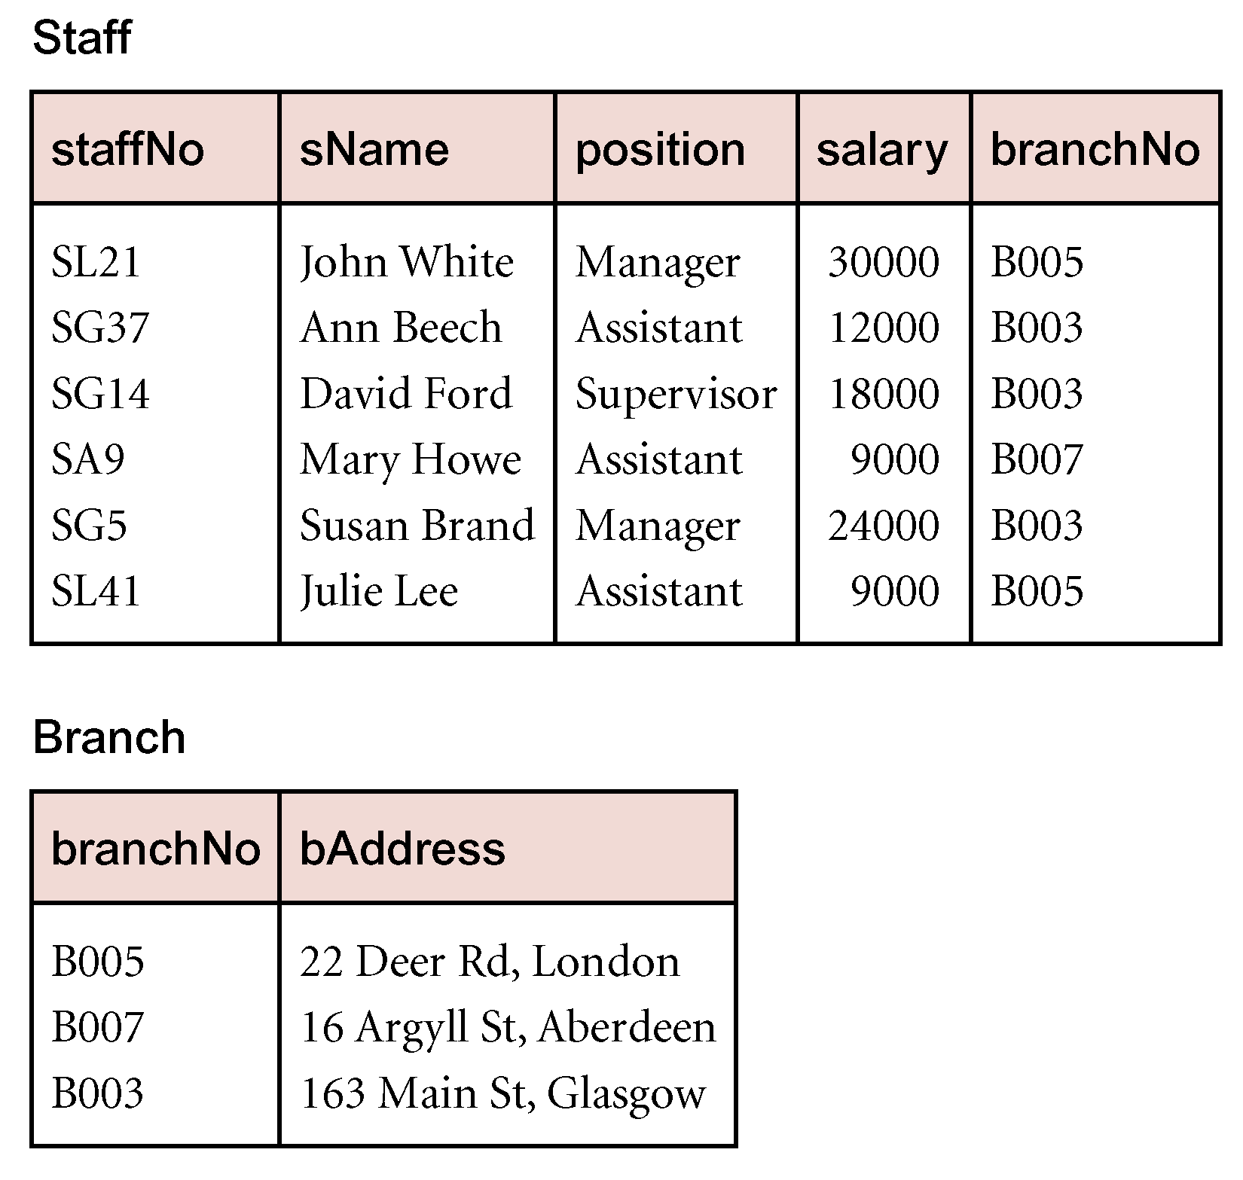
Data Redundancy and Update Anomalies
Major aim of relational database design is to group attributes into relations to minimize data redundancy.

Slide 8
Data Redundancy and Update Anomalies
StaffBranch relation has redundant data; the details of a branch are repeated for every member of staff.
In contrast, the branch information appears only once for each branch in the Branch relation and only the branch number (branchNo) is repeated in the Staff relation, to represent where each member of staff is located.

Slide 9
Data Redundancy and Update Anomalies
Relations that contain redundant information may potentially suffer from update anomalies.
Types of update anomalies include
Insertion
Deletion
Modification

Slide 10
Functional Dependencies
Important concept associated with normalization.
Functional dependency describes relationship between attributes.
For example, if A and B are attributes of relation R, B is functionally dependent on A (denoted A → B), if each value of A in R is associated with exactly one value of B in R.

Slide 11
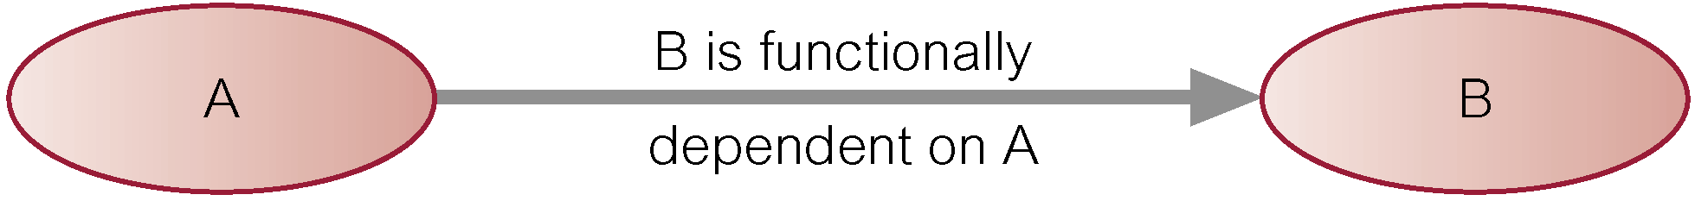
Characteristics of Functional Dependencies
Property of the meaning or semantics of the attributes in a relation.
Diagrammatic representation.
The determinant of a functional dependency refers to the attribute or group of attributes on the left-hand side of the arrow.

Slide 12
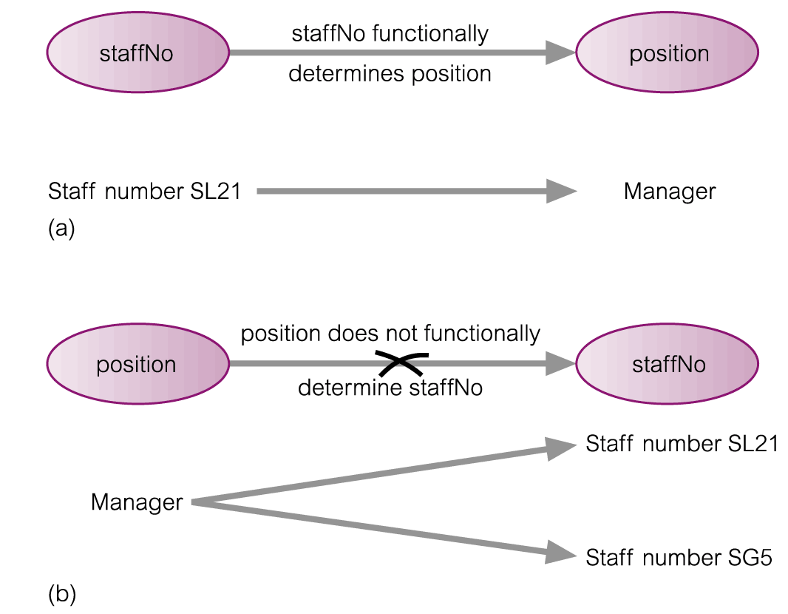
An Example Functional Dependency

Slide 13
Example Functional Dependency that holds for all Time
Consider the values shown in staffNo and sName attributes of the Staff relation.
Based on sample data, the following functional dependencies appear to hold.
staffNo → sName
sName → staffNo

Slide 14
Example Functional Dependency that holds for all Time
However, the only functional dependency that remains true for all possible values for the staffNo and sName attributes of the Staff relation is:
staffNo → sName

Slide 15
Characteristics of Functional Dependencies
Determinants should have the minimal number of attributes necessary to maintain the functional dependency with the attribute(s) on the right hand-side.
This requirement is called full functional dependency.

Slide 16
Characteristics of Functional Dependencies
Full functional dependency indicates that if A and B are attributes of a relation, B is fully functionally dependent on A, if B is functionally dependent on A, but not on any proper subset of A.

Slide 17
Example Full Functional Dependency
Exists in the Staff relation.
staffNo, sName → branchNo
True - each value of (staffNo, sName) is associated with a single value of branchNo.
However, branchNo is also functionally dependent on a subset of (staffNo, sName), namely staffNo. Example above is a partial dependency.

Slide 18
Characteristics of Functional Dependencies
Main characteristics of functional dependencies used in normalization:
There is a one-to-one relationship between the attribute(s) on the left-hand side (determinant) and those on the right-hand side of a functional dependency.
Holds for all time.
The determinant has the minimal number of attributes necessary to maintain the dependency with the attribute(s) on the right hand-side.

Slide 19
Transitive Dependencies
Important to recognize a transitive dependency because its existence in a relation can potentially cause update anomalies.
Transitive dependency describes a condition where A, B, and C are attributes of a relation such that if A → B and B → C, then C is transitively dependent on A via B (provided that A is not functionally dependent on B or C).
Pearson Education © 2009

Slide 20
Example Transitive Dependency
Consider functional dependencies in the StaffBranch relation
staffNo → sName, position, salary, branchNo, bAddress
branchNo → bAddress
Transitive dependency, branchNo → bAddress exists on staffNo via branchNo.

Slide 21
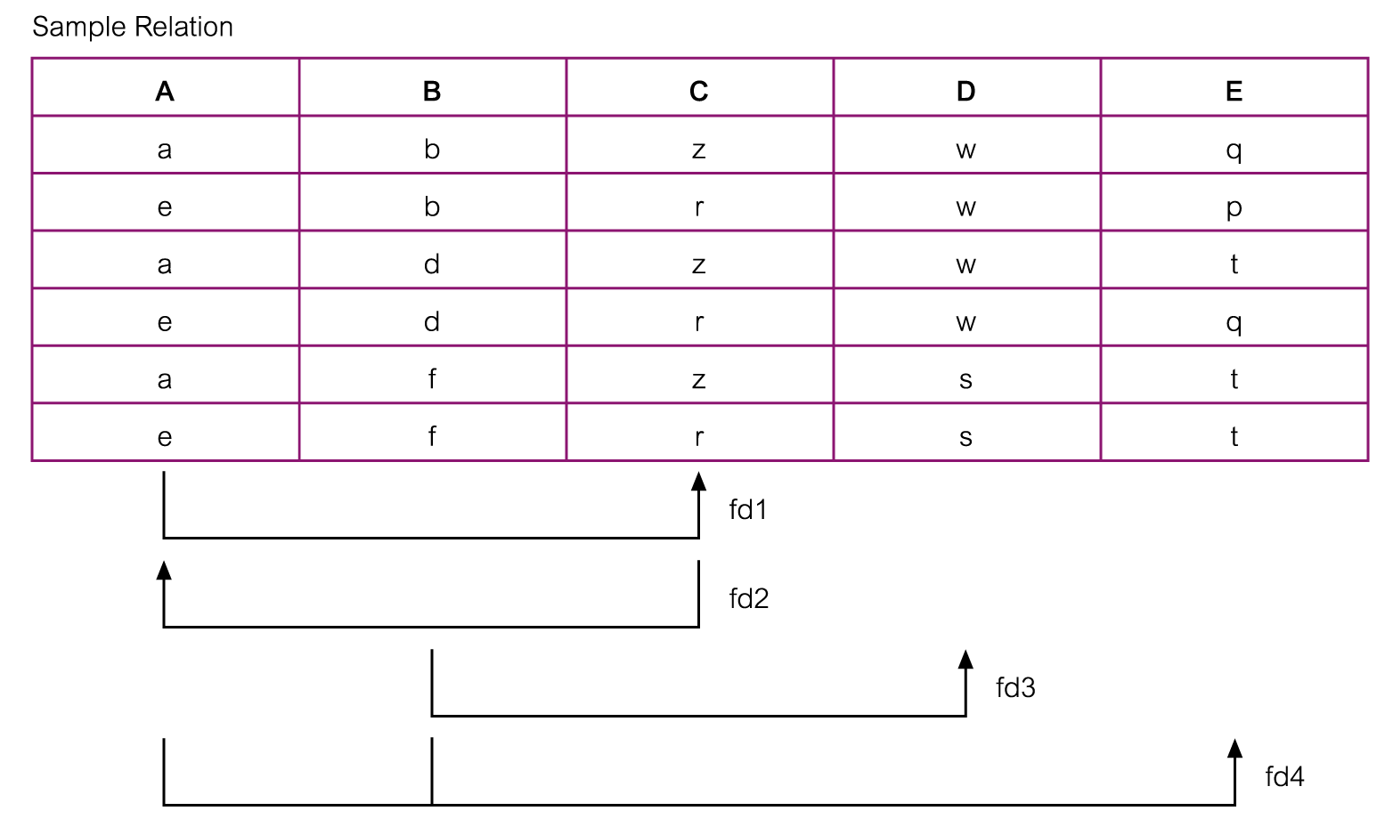
Example - Using sample data to identify functional dependencies.

Slide 22
Example - Using sample data to identify functional dependencies.
Function dependencies between attributes A to E in the Sample relation.
A → C (fd1)
C → A (fd2)
B → D (fd3)
A, B → E (fd4)

